Slide 1
Key Insights for
Gamezone.co – an E-commerce Gaming company 🎮
We are solving one key Business Problem Statement for the Executive team:
How can we improve the effectiveness of our sales and marketing efforts across marketing channels, products, and countries, based on customer behavior and transaction patterns?

Slide 2
Project Scope & Dataset Overview:
Dataset Highlights:
Transactional data from Gamezone.co
Covers 2019–2021 (3-year window)
Includes 20,000+ entries across:
  Products purchased
  Purchase & shipping dates
  Platforms and marketing channels
  Country of purchase
Objective of this analysis:
This analysis is designed to equip teams develop a tailored plan that caters to audience’s evolving demands real-time.
It aims to support decision-making across:
The executive team: with high-level trends and growth opportunities
The marketing team: by identifying top-performing channels and timing
The portfolio and pricing teams: by uncovering product and country-level opportunities for targeted strategy

Slide 3
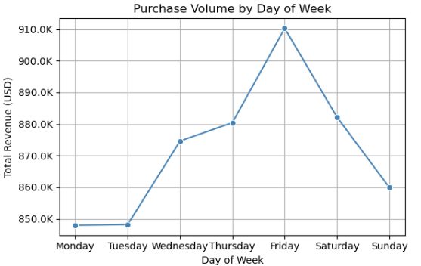
Fridays seem the prime day of maximum customer activity, suggesting marketing campaign and offer timelines to be planned accordingly
Insight:
While the start of the week witnesses moderate sales, the volume consistently increases till it reaches its peak on Fridays (+7% since the start of the week). It then sees a marginal decline over the weekends.
So what? (Business importance)
Fridays offer a window to influence buyer behavior. Customers are more active, thus giving a prime opportunity to drive conversions before the weekend slowdown.
Recommended Action:
Time key promotional campaigns, product launches, or limited-time offers/ discounts on Fridays to capitalise on peak demand.
Peak Sales

Slide 4
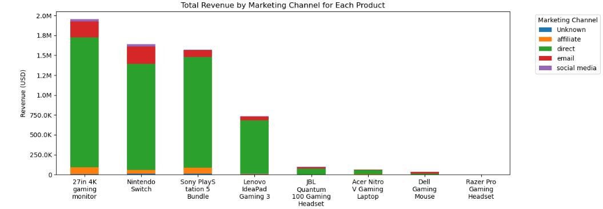
Direct marketing drives top product revenue; social media remains underleveraged.
Insight:
The 27in 4K Gaming Monitor, Nintendo Switch, and PS5 Bundle are the top 3 revenue-driving products with Direct marketing being the most effective channel across all three, followed by email marketing.
Complete product bundles (consoles + accessories) sell more consistently than standalone accessories — except for the monitor, which is a popular outlier.
Social media channels contribute minimally, suggesting potential for growth
So what? (Business Importance)
Channel ROI is currently concentrated, indicating scope for more effective diversification.
Untapped potential on social media means we're missing awareness opportunities, especially with younger, gaming-savvy buyers.
Accessory-focused products might be suffering from low channel visibility.
Recommended Action:
Double down on Direct and Email for top-performing bundles — . Maintain the momentum where ROI is clear.
Design targeted social campaigns (UGC contests, influencer partnerships) for underperforming accessories and emerging products.

Slide 5
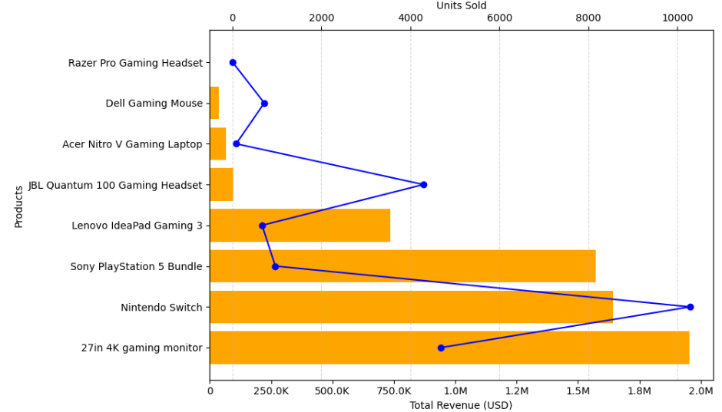
Striking the right balance between volume vs price value is important – the current contrast between the variables gives key insights into pricing strategies
Insight:
27in 4K Gaming Monitor, PS5, and Lenovo products show high revenue despite lower unit sales, indicating strong per-unit profitability. These are prime candidates for aggressive marketing and bundling promotions.
The PS5 Bundle has a significant revenue–volume mismatch, suggesting room to test a price increase without hurting demand.
The JBL Gaming Headset shows high unit sales but lower revenue contribution. Consider modest price increases or bundling to boost per-unit value.
Several products fall in the low-volume, low-revenue quadrant.
So what? (Business importance)
High-volume items with low revenue might be underpriced or under-leveraged – need for revenue optimisation. (JBL, Nintendo)
Some low-performing items need assessment of demand or repositioning. (Lenovo, PS5)
Recommended Action:
Test price increases on PS5 and JBL Headset via A/B pricing campaigns to assess elasticity.
Review low-performing products for potential repositioning, bundling, or discontinuation based on marketing ROI.
Total Revenue (USD)
Units Sold

Slide 6
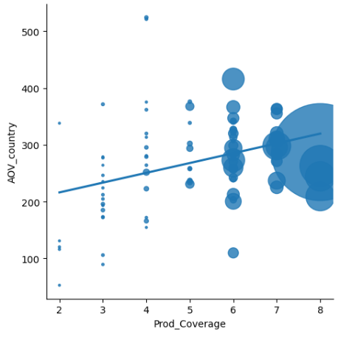
Only 37% of the 150 countries have explored more than 4 products – thus highlighting scope of expanding portfolio coverage
*8- 3%
7- 9%
6-18%
5-7%
4-10%
3-19%
2-16%
1-19%
*The numbers indicate unique products sold in the respective country
% refers to the % of countries out of 150
Correlation between Product Portfolio coverage vs Average
Order Value (Size = Orders Count)
Insight:
Countries with higher product coverage (5–6+) tend to have higher AOVs, especially when backed by a decent number of orders.
Countries in the 3–4 product bucket show high variability in AOV.
So what? (Business Importance)
Product visibility and awareness may be low in key regions, causing customers to stick to familiar or limited offerings.
This creates a missed opportunity for both cross-selling and increasing order size.
Recommended Action:
Launch product discovery campaigns in underperforming countries.
Create strategies to promote lesser-known products alongside top-sellers.

Slide 7
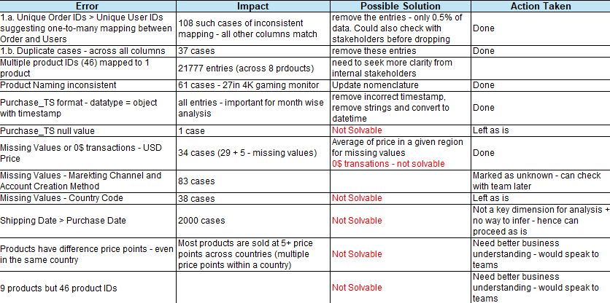
The approach followed for the analysis:
Understanding and conceptualising the data: Identified critical columns for analysis, understood the data structure, and made note of questions that can be answered for the business (sales drivers, product diversity, increasing AOV, etc.)
Data Cleaning and Preparation: Evaluated the consistency of the dataset, checked consistency in terms of business logic, missing values. Created a log as follows:
Identified the limitations/ assumptions to keep in mind. For example:
  Dollar value differs even for the same product within and across countries
  Business logic inconsistency: Shipping date > Order date for 2000 cases
Exploratory Analysis (Python: numpy and pandas - Jupytr notebook link here):
  Grouped, segmented, and aggregated data to extract patterns across products, channels, and countries.
  Analyzed various variables of the data to understand repeat user trend/ frequency, operational efficiency such as shipping delays, average price point and variance in the price range of products across countries, and so on
Visualization (Python: matplotlib, seaborn):
  Created clear, interpretable visual summaries to support each insight
Final Storylining for clear business impact: Framed each insight using “Insight → So What → Recommendation” for clarity and actionability

Slide 8
THANK YOU!

